Slide 1
Writing a Web Service

Slide 2
Module Overview
In this Module, we will learn the following:
Writing a Web service Client: Stub generation
Writing a Web service Client: Calling the Service
Setting up Java EE7SDK
Writing a Web Service: Eclipse setup
Writing a Web Service: Code and Deploy
Adding Input Arguments
Service First and Contract First Web Services

Slide 3
Writing a Web service Client: Stub generation
SOAP (Simple Object Access Protocol) is a protocol to specify exchange of structured information in the implementation of web services over computer networks.
It uses XML Information Set for its message format, and relies on application layer protocols, mostly Hypertext Transfer Protocol (HTTP) or Simple Mail Transfer Protocol (SMTP), for message negotiation and transmission.
Webservice are of two types
SOAP — uses JAX-WS Specification REST — uses JAX-RS Specification
web service is a service that is made available over the internet. The main difference between a website and webservice is that
A web service is a unit of managed code that can be remotely invoked using HTTP, that is, it can be activated using HTTP requests. It allows us to expose the functionality of your existing code over the network. After it is exposed on the network, other application can use the functionality of your program.
A web site is collection of web pages, also it can have many functions and can be used in various fashions, a website can be a personal website, a corporate website for a company, a government website, an organization website, etc.

Slide 4
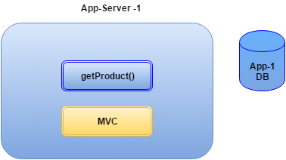
Writing a web service
Let’s see this with an example
Suppose we have to write a business webservice for product which will have a method called getproduct().
A webservice make two different application hosted on different server talk to each other.
They can call method eachother methods.
Another advantage is that you can write the webservice in other technology (interoperability)
Depends on the technology best suited for your business logic you can use that technology.

Slide 5
Demo: Writing Web Service Stub Generation
Duration: 15 min
We will see how to write code for writing Web Service Client.
Java application that consumes webservice i.e. a webservice client Below is the url for a webservice available on net http://webservicex.com/ws/WSDetails.aspx?CATID=12&WSID=64
Step 1:
We will create a client for this.
Let’s see the WSDL for the above webservice. Paste below url in browser.
wsimport http://www.webservicex.net/geoipservice.asmx?WSDL
within every WSDL we will have an element called <wsdl:service name="GeoIPService"> which tells you the name of the service , It also has the port details.
As this is a remote method call, we have to use something called as service endpoint. For this we have to generate the stub using the java tools.
The stub internally translate the call to a webservice call
Step 2:
Open command prompt and create one directory by any name and type
Wsimport
Make one directory and from command prompt go to that directory. And run below command.
wsimport http://www.webservicex.net/geoipservice.asmx?WSDL
If it does not work then
set PATH=%PATH%;C:\Program Files\Java\jdk1.8.0_66\bin

Slide 6

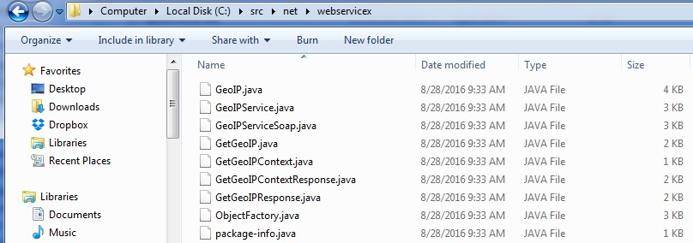
Demo: Writing Web Service Stub Generation Cont..
The default behaviour of the wsimport is that it imports the java files then compiles it and then delete the java files, but we would need the java file so we can use option present with the wsimport command and rewrite the command as
wsimport -keep -s src http://www.webservicex.net/geoipservice.asmx?WSDL
This will keep the java files in the src directory which we have created

Slide 7
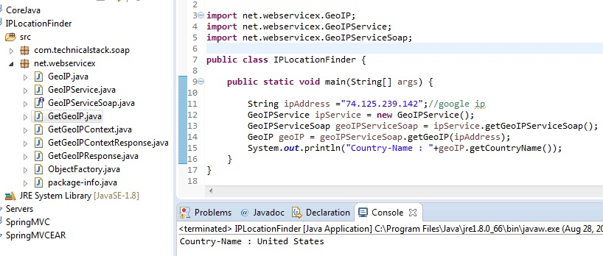
Demo: Writing Web Service Stub Generation Cont..
It will create a directory called net and a sub directory webservicex.
Now using the stub(these class) we can call the webservice.
You can see the output in the console.

Slide 8
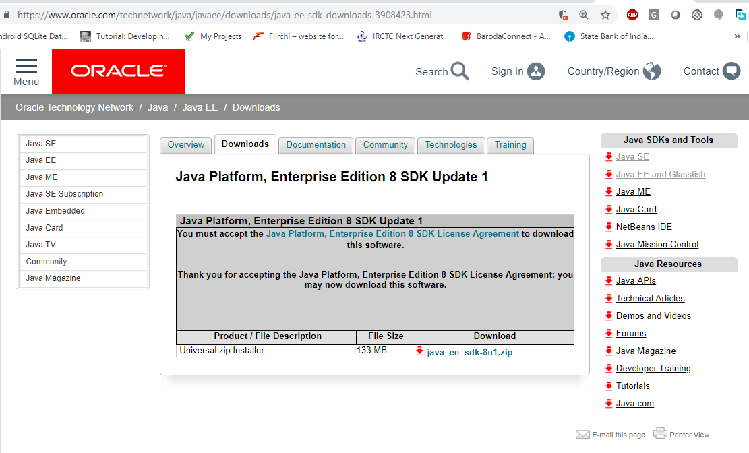
Setting up Java EE 7 SDK
Duration: 30 min
Download latest version or jdk 8 version and install it
Set the JAVA_HOME AND Path variables in environment variable of system properties
Go to oracle website and download JEE8 sdk

Slide 9
Setting up Java EE 7 SDK Cont..
After downloading Java EE 8 sdk, extract the folder to specific drive.
Go to command prompt and go to C:/Program Files/glassfish5/glassfish/bin location
To Start GlassFish Server Using the Command Line
To start GlassFish Server from the command line, open a terminal window or command prompt and execute the following:
asadmin start-domain --verbose
A domain is a set of one or more GlassFish Server instances managed by one administration server. The following elements are associated with a domain:
The GlassFish Server port number: The default is 8080.
The administration server’s port number: The default is 4848.
An administration user name and password: The default user name is admin, and by default no password is required.
You specify these values when you install GlassFish Server.
With no arguments, the start-domain command initiates the default domain, which is domain1.
The --verbose flag causes all logging and debugging output to appear on the terminal window or command prompt. The output also goes into the server log, which is located in domain-dir`/logs/server.log`

Slide 10
Setting up Java EE 7 SDK Cont..
To Stop GlassFish Server Using the Command Line
To stop GlassFish Server, open a terminal window or command prompt and execute:
asadmin stop-domain domain1
Starting the Administration Console
To administer GlassFish Server and manage users, resources, and Java EE applications, use the Administration Console tool. GlassFish Server must be running before you invoke the Administration Console. To start the Administration Console, open a browser at http://localhost:4848/.
Starting and Stopping Apache Derby
GlassFish Server includes Apache Derby.
To start Derby from the command line, open a terminal window or command prompt, change to the as-install/bin directory, and execute:
asadmin start-database
To stop Derby from the command line, open a terminal window or command prompt, change to the as-install/bin directory, and execute:
asadmin stop-database

Slide 11
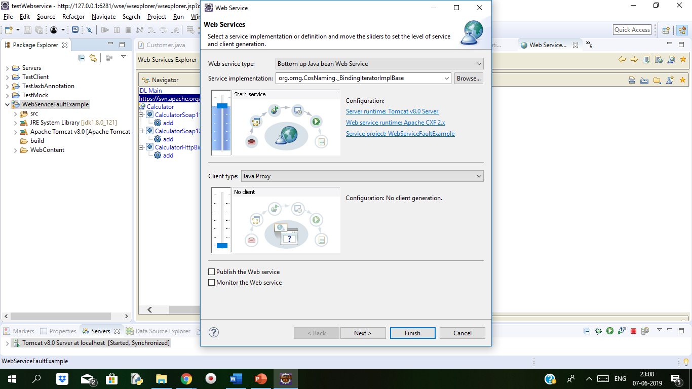
Writing a Web Service: Eclipse setup
Use the Java EE IDE. It comes bundled with necessary plugins.
Eclipse by default uses Apache Axis to implement the web service and it provides option to use our choice of web service engine. In this slides we are using the default bundled Apache Axis.

Slide 12
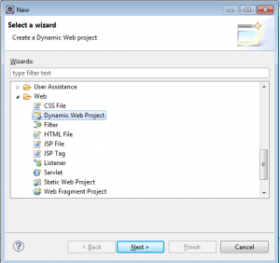
Writing a Web Service: Eclipse setup
1. Create a Dynamic Web Project
Use the new project from menu and open project wizard. Select ‘Dynamic Web Project’ and click next. Then give a project name and select a target runtime here its tomcat 7.0 you can select 8.0 or later and leave all other default values and click next to finish.
Create a New Runtime
If the run time is not already defined, then click New Runtime and select the version of Tomcat you have installed (already) then click next. Now browse the path of Tomcat home directory and click finish.

Slide 13
Writing a Web Service: Eclipse setup
2. Create Web Service Provider Java Class
Create a new package under ‘Java Resources – src’ named com.mywebservice.test Then, create a new java class under that package. This is the web service’s service provider class.
package com.mywebservice.test
public class AnimalTypeService {
public String animalType(String animal) {
String animalType = "";
if ("Lion".equals(animal)) {
animalType = "Wild";
} else if ("Dog".equals(animal)) {
animalType = "Domestic";
} else {
animalType = "I don't know!";
}
return animalType;
}
}

Slide 14
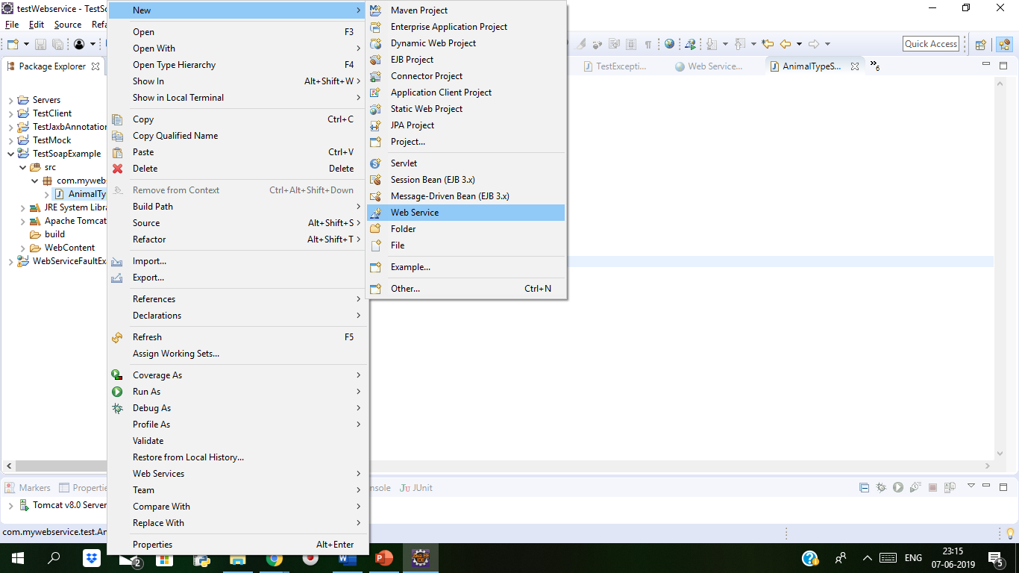
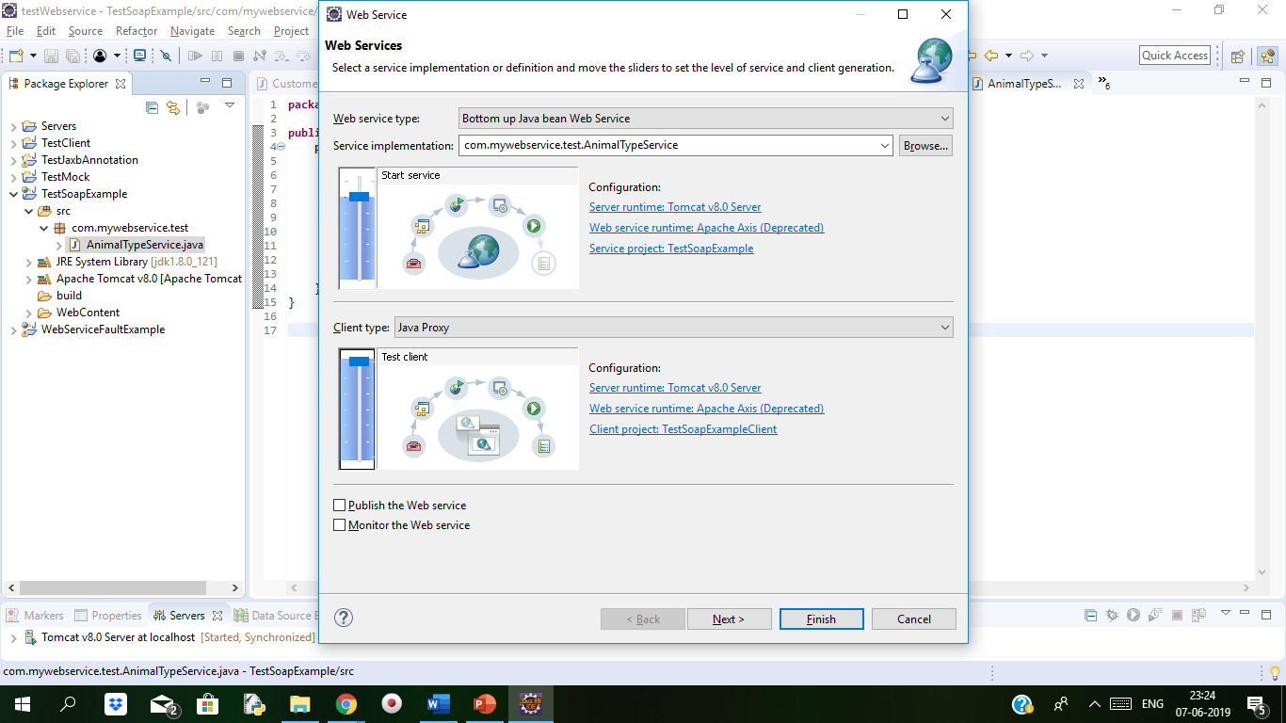
Writing a Web Service: Eclipse setup
Select Service Implementation
In this Web Service wizard, use the browse button and select the java class written earlier. Which is our service implementation java class. Then, drag the slider bar to upper most in both service and client part. Then, enable the Publish the Web service check box.
Web Service Client Creation
Added to configuring the service implementation, we are instructing Eclipse to generate a web service client also. This will create a dynamic web java project and create a web service client for the web service created. Instead of that we can also create a java project and write a client to access the web service.

Slide 15
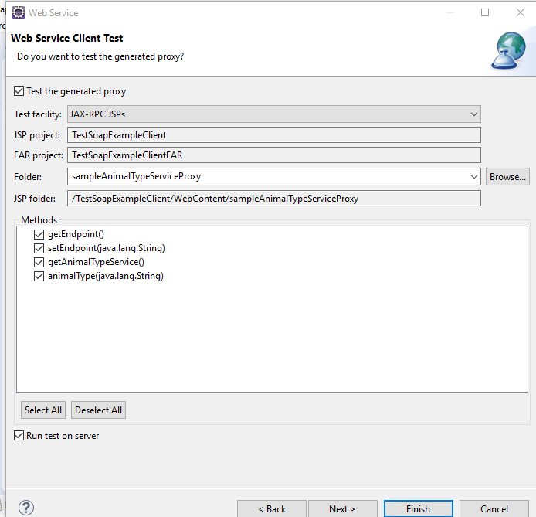
Writing a Web Service: Eclipse setup
Deploy Web Service and Client
Click Next till the Server Startup wizard and then click Start Server. This step will start the associated runtime Tomcat
4. Test Web Service
We can test the web service using a web service client. For this we need to create web service client application. In our previous configuration we moved the slider above in service configuration wizard which will create a web service client application.

Slide 16
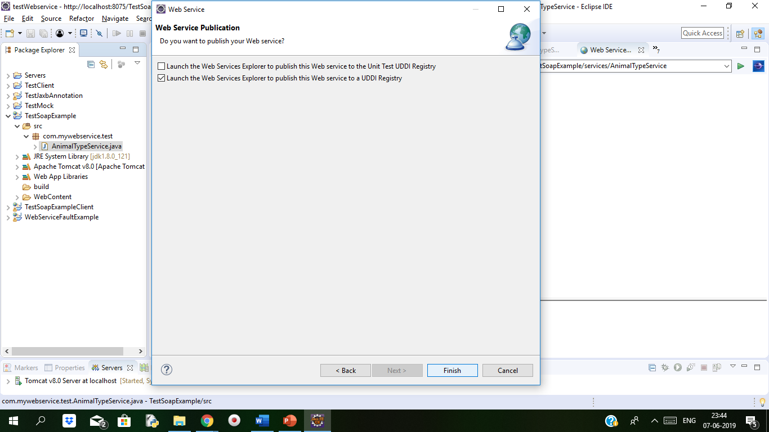
Writing a Web Service: Eclipse setup
Eclipse Web Service Explorer
The another way is that
Eclipse provides a Web Service Explorer. It is a nice client that will help us test a web service client.
Then click Next to reach ‘Test Web Service’ wizard and then click Launch button.

Slide 17
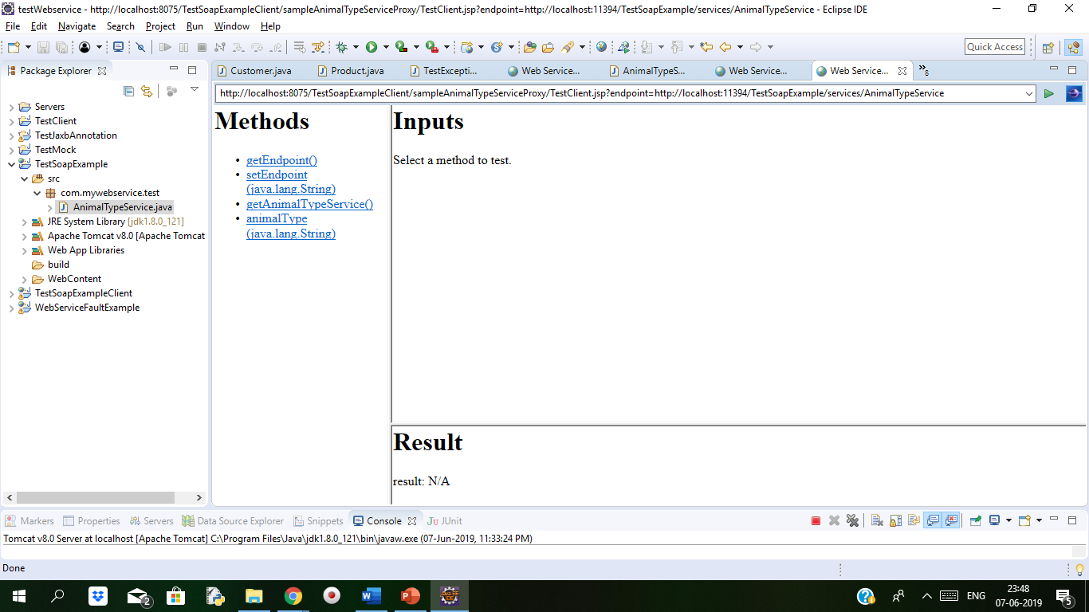
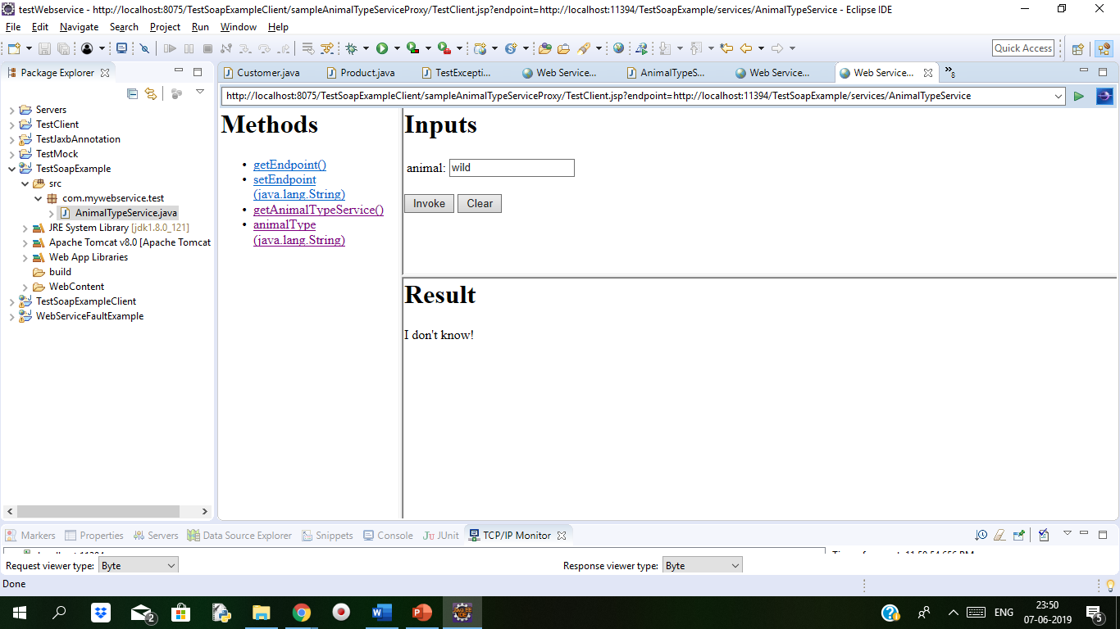
Writing a Web Service: Eclipse setup
Web Service Client Application
Then click next and we will see the web service client application generated. See in the image below, EclipseWebServiceClient is a web application generated by Eclipse.
Open the EclipseWebServiceClient application and go through the code and generated Stub, Proxy and all the files. It will make to understand more.
The result of method invocation as above seen in image

Slide 18
Demo: Writing a Web Service: Code and Deploy
Duration: 20 min
We will understand how to create your own simple java web service.
We need to set up a server to host the web service. We have glassfish server 5.0 used in this example which allows us to host a local server on our system.
1. Create a Dynamic Web Project
Use the new project from menu and open project wizard. Select ‘Dynamic Web Project’ and click next. Then give a project name and select a target runtime here its Glassfish server 5.0 and leave all other default values and click next to finish.
Creating a Web Service
In the projects window, right click the Source Packages folder, go to New and from the list Select Java Class. You can choose Web Service and it will create a fully generated web service class with some example methods. But for the time being, just create a new Java Class.
Now create a public method inside the new public method with the following code:

Slide 19
Demo: Writing a Web Service: Code and Deploy Cont..
public class SimpleWebService
{ public String sayHello(String name){ return "Hello " + name + "!"; }
}
How we can turn it into a web service? We will add the annotation @WebService above the class, add @WebMethod above the sayHello method and import their classes.
import javax.jws.WebMethod;
import javax.jws.WebService;
@WebService
public class SimpleWebService { @WebMethod public String sayHello(String name){ return "Hello " + name + "!"; }
}

Slide 20
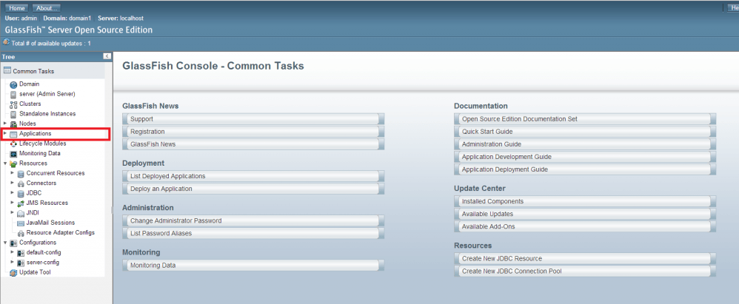
Demo: Writing a Web Service: Code and Deploy Cont..
Deploying the Web Service
To get the web service running on the server, follow these steps:
Right click your project and select “Clean and Build”.
After the projects built, right click it again and select export to war and store that war file in glassfish servers autodeploy folder
we need to check that Glassfish has successfully deployed the service. To do this, we need to go to the console, which we access via a browser. Navigate to localhost:4848. Once the console is loaded, go to Applications on the sidebar.

Slide 21
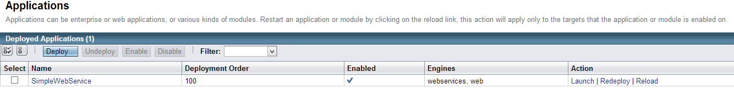
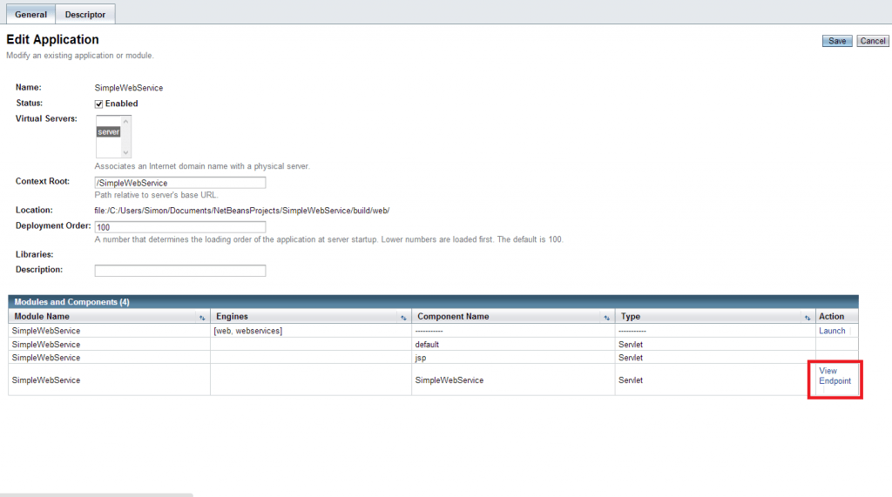
Demo: Writing a Web Service: Code and Deploy Cont..
You should be able to see your java web service listed as an application.
Click on the name of the web service to open the Edit Application. On the table at the bottom find the action called “View Endpoint”.

Slide 22
Demo: Writing a Web Service: Code and Deploy Cont..
We can see on a page a couple of links. The first link takes you to the previous page. The second link offers a tester utility which allows us to test the web service without the need of creating a client application, it also allows us to view the raw SOAP XML. The third one allows us to look at the actual WSDL generated for the web service.
Go to the second link (the URL ending in ?Tester) and click the first link (with the port 8080). You should see the following:
Click on the name of the web service to open the Edit Application. On the table at the bottom find the action called “View Endpoint”.

Slide 23
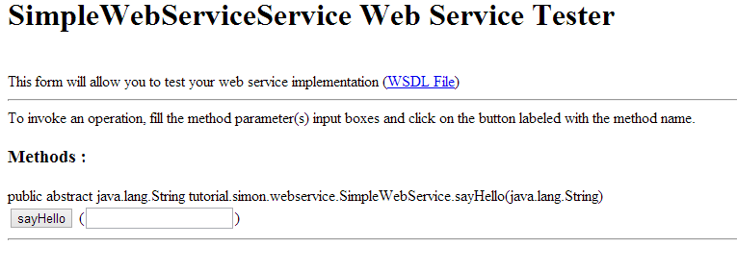
Demo: Writing a Web Service: Code and Deploy Cont..
Type something into the text box and press the “sayHello” button. We can now view the SOAP request and response generated.

Slide 24
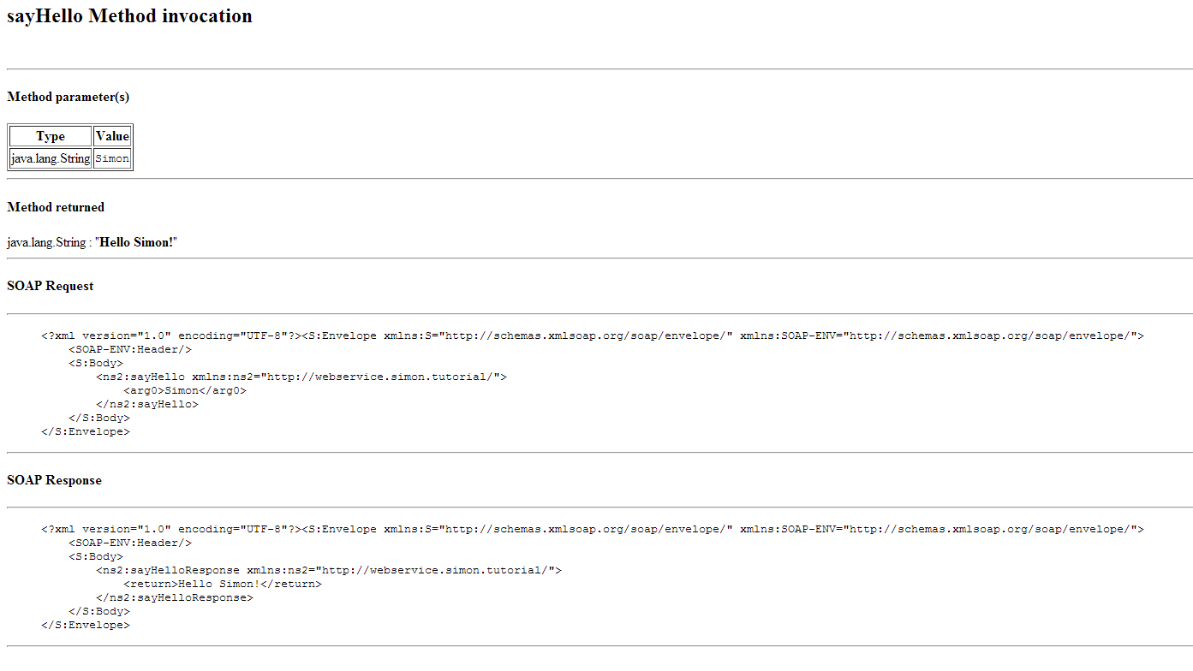
Demo: Writing a Web Service: Code and Deploy Cont..
We have noticed that the elements in the SOAP body are generic with “sayHello” and “arg0” tags. to make these look nicer, we need to add some parameters to our annotations in the java web service class.

Slide 25
Demo: Writing a Web Service: Code and Deploy Cont..
import javax.jws.WebMethod;
import javax.jws.WebParam;
import javax.jws.WebService;
// The url will now be .../HelloService
@WebService(serviceName="HelloService")
public class SimpleWebService {
// The method element in the XML will now be SayHello @WebMethod(operationName="SayHello")
// @WebParam will rename the input from arg0 to name public String sayHello(@WebParam(name="name") String name){
return "Hello " + name + "!";
}
}
Redeploy the application and navigate back to the Tester utility, type in a value and press “sayHello”, the SOAP XML should now look like this:

Slide 26
Demo: Writing a Web Service: Code and Deploy Cont..
We have seen how to create a small web service and how to do some simple testing from within Glassfish.

Slide 27
Service First and Contract First Web Services
In the contract-first web service, the "contract" (a WSDL definition of operations and endpoints and XML schema of the messages) have to created first, without actually writing any service code.
In the contract-last web service, existing logic is "exposed" as a web service and the contract is created at the very end. We will see both advantages and disadvantages of each implementation.
History of SOAP
The SOAP originally meant Simple Object Access Protocol, but later it was dropped and now SOAP is an official name by itself. Coincidently, SOAP can also mean SOA Protocol or Service Oriented Architecture Protocol, but no one currently is using this definition. The SOAP-based WS are the source of income of some enterprise developers; since the original introduction of the standard, it has changed a lot. The current SOAP specification (XML) defines the envelope structure, encoding rules, and conventions for representing requests and responses.

Slide 28
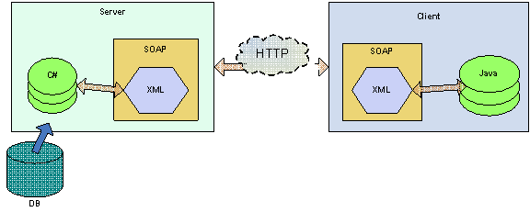
Service First and Contract First Web Services Cont..
The Flow of SOAP Requests and Responses
For better understanding both types of the web service methodologies, the communication flow needs to be discussed first. Because the web services XML standards are platform and language indifferent, the translation of parameter values (passed in the request and response) into the host system technology needs to take place on both the client and the server. This includes any complex types, such as custom objects.
For example, if the server is based on dotnet and the client on Java, C# dot net structures are mapped into XML, which is passed to the client. Subsequently, the client needs to un-wrap XML into the Java object model.
This process is called XML marshalling and un-marshalling (also knows as the plumbing of the web services). Below Figure The diagram of XML request marshalling.

Slide 29
Service First and Contract First Web Services Cont..
In many cases, the client-object model can be automatically generated with the use of the object-XML mapping tool or an IDE. Most popular object-XML mapping (OXM) toolkits for Java are:
Castor
Jaxb
Jibx
XMLBeans
XStream
These tools can create the XML from the object model, which then can be used by the web service toolkit such as Apache Axis, Xfire, or Spring-WS.
What Is a Web-Service Contract?
Even though there is no official definition of the web-service contract, the contract is assumed to be the WSDL file. The WSDL describes all operations that the service provides, locations of the end-points (where the service can be invoked), and simple and complex elements that can be passed in requests and responses.

Slide 30
Service First and Contract First Web Services Cont..
Contract-First vs. Contract-Last
In the case of contract first, clients are decoupled from any logic on the server. The logic can be revised on the server without affecting the clients. Teams can work simultaneously on the server and the client implementations as long as they agree on the contract, which is the first thing that is created anyway.
OXM libraries can be replaced/changed based on the implementation, and potentially even web service toolkits also can be changed.
In the case of contract-last, developers don't need to learn SOAP or any XML-related technologies, and services are created quickly by "exposing" internal APIs with automated tools, such as JBuilder or .NET Studio.

Slide 31
Summary
In this Module, we have learnt the following:
Writing a Web service Client: Stub generation
Writing a Web service Client: Calling the Service
Setting up Java EE7SDK
Writing a Web Service: Eclipse setup
Writing a Web Service: Code and Deploy
Adding Input Arguments
Service First and Contract First Web Services

Slide 32

Thank You

